Slide 1
AMAZON FRESH ANALYTICS
Using SQL to Identify Key Business Insights and Solutions
Prepared by: Bharathi. S

Slide 2
PROJECT OBJECTIVE
Analyze Amazon Fresh sales and customer data using SQL queries.
Identify top products, customer patterns, and inventory issues.
Provide data-backed business recommendations.

Slide 3
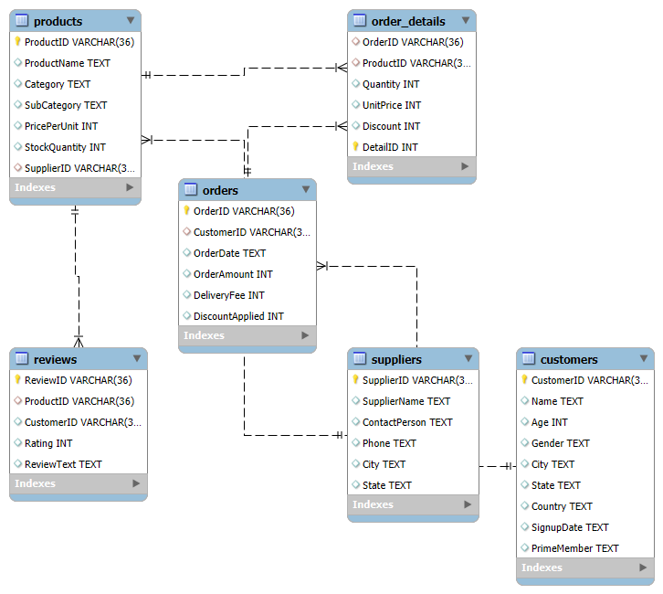
DATA MODEL OVERVIEW (ER DIAGRAM)
Entity-Relationship diagram showing key connections across Customers, Orders, Products, and Inventory

Slide 4
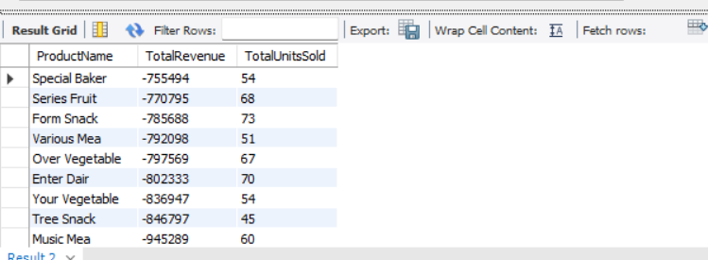
TOP PERFORMING PRODUCTS
Which products drive the most revenue?
Insight: A few top products contribute a large share of revenue. Focus marketing efforts here.

Slide 5
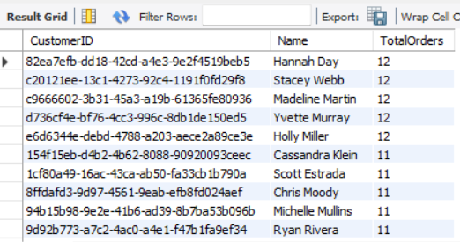
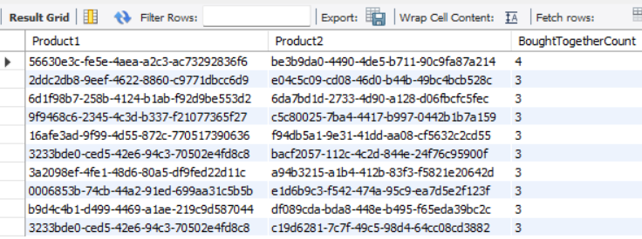
CUSTOMER PURCHASING PATTERNS
Who are loyal customers? Which products are bought together?
Insight: Significant portion of customers are repeat buyers. Cross-sell opportunities identified.

Slide 6
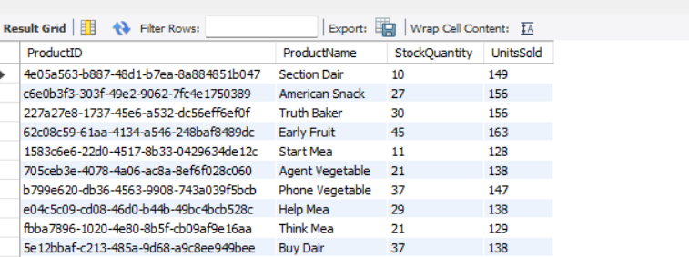
INVENTORY MANAGEMENT
Are we managing stock effectively?
Insight: Overstock observed in slow-moving items; frequent stockouts in high-demand SKUs

Slide 7
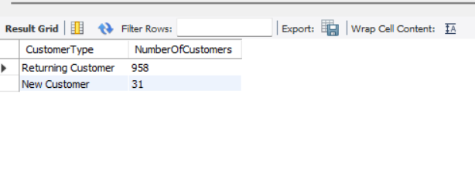
NEW VS RETURNING CUSTOMERS
How does customer retention look?
Insight: Majority are new customers. Opportunity to strengthen retention campaigns.

Slide 8
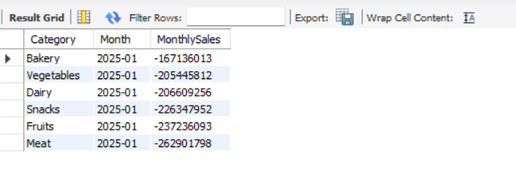
SALES TREND BY CATEGORY
What are the sales trends across categories?
Insight: Adjust marketing & stock by category trends. Seasonal patterns found in Fresh Produce and Dairy. Frozen Foods maintain stability.

Slide 9
SWOT ANALYSIS
Strengths | Weaknesses | Opportunities | Threats
Large customer base, diverse product range. | Uneven supplier performance, low review rate. | Improve product listings via feedback loop. | Competition from local delivery services.

Slide 10
SUMMARY OF FINDINGS
Top products dominate sales — promote them aggressively
Loyal customers exist — retention efforts are worthwhile
Inventory shows mismatch — improve forecasting and restocking
Most customers are new — retention and engagement need work
Sales are seasonal — adjust strategy by category

Slide 11
SUMMARY & RECOMMENDATIONS
Prioritize high-revenue products in ads and promotions
Launch loyalty program targeting repeat buyers
Use stock vs sales data to fine-tune inventory levels
Create retention workflows for new customers
Plan category-level promotions based on seasonal demand

Slide 12
CONCLUSION
Business insights reveal clear opportunities for growth
Data supports targeted action across sales, inventory, and customer engagement
Applying these insights can improve profitability and customer satisfaction

Slide 13
THANK YOU

